Slide 1
Final Presentation
2022暑期緯創之星實習生
中原大學資訊工程學系碩士二年級 - 林冠良

Slide 2




Final integration
Send brightness commands to MCU through UART (e.g. Bright 095).
Return “Success” if valid value
Else “Fail”.
Store the brightness value in EEPROM through I2C.
Retrieve the brightness value from EEPROM automatically each time the program restarts and set the brightness of LD4.
NB
STM32
EEPROM
User
Command
Brightness
Value
UART
I2C
GPIO (PWM)
LD2

Slide 3
Implementation
Final_Integration

Slide 4
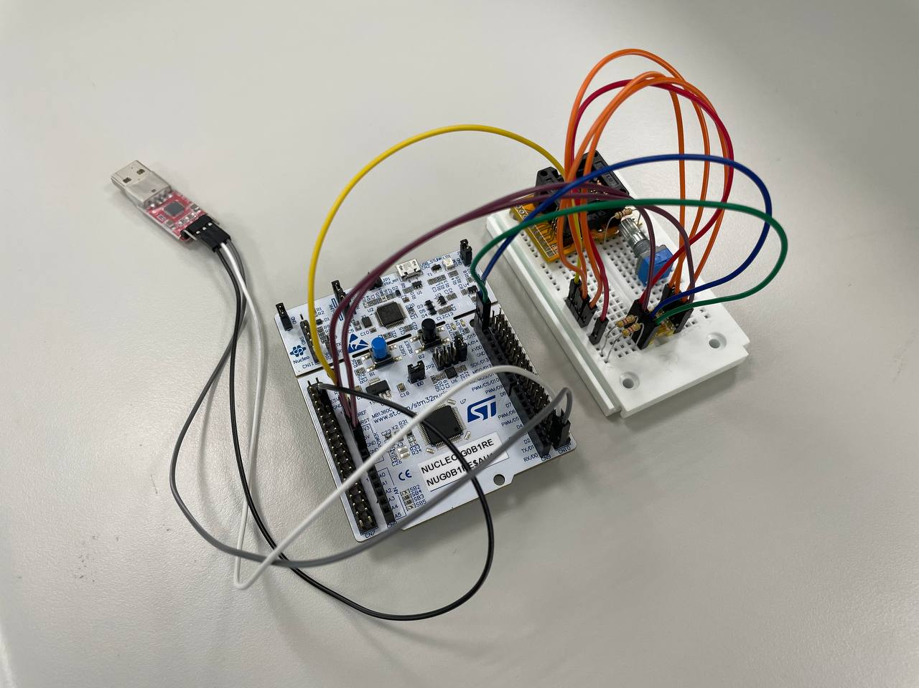
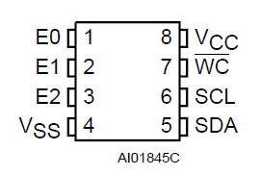
Circuit
E0, E1, E2 and VCC connected to 3V3 in series.
VSS and WC connected to GND.
SCL connected to PB8.
Pull up with 4.7kΩ resistor
SDA connected to PB9.
Pull up with 4.7kΩ resistor
UART_RX connected to PC4.
UART_TX connected to PC5.

Slide 5
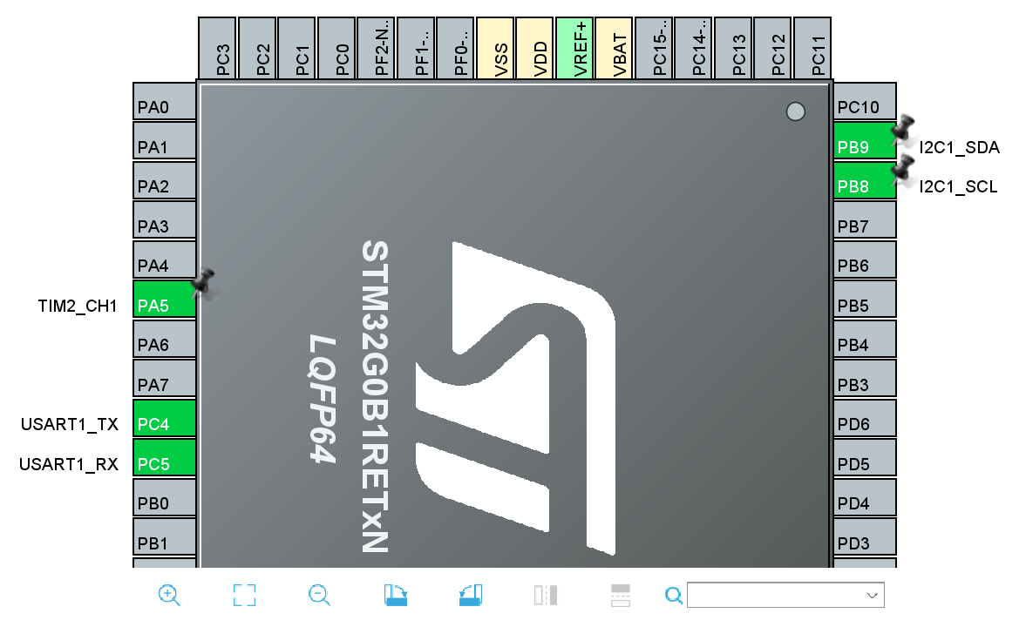
Set the pins
PA5 (LD1)
TIM2_CH1
PC4
USART1_TX
PC5
USART1_RX
PB9
I2C1_SDA
PB8
I2C1_SCL

Slide 6
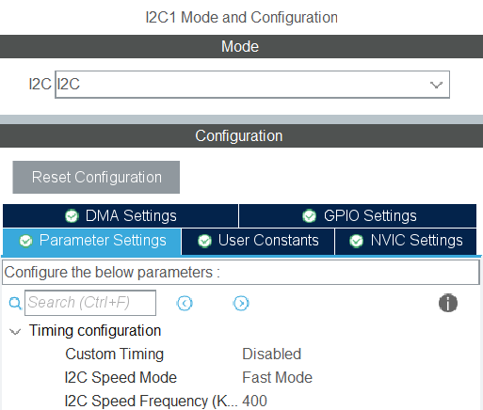
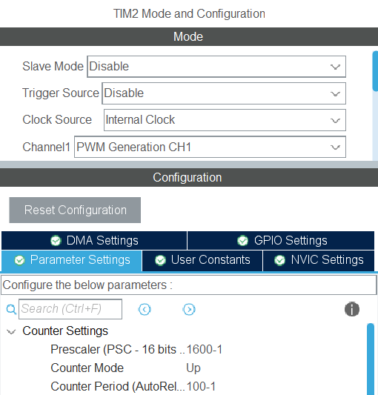
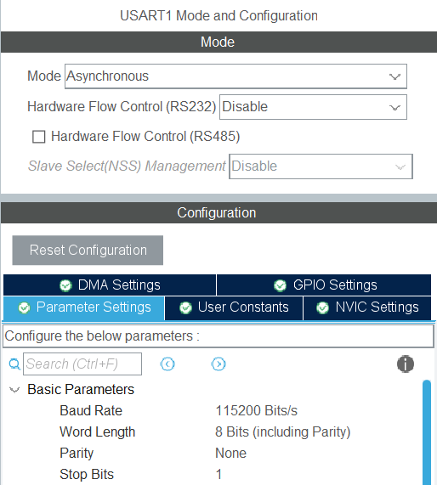
Enable each interface
TIM2
Channel 1: PWM Generation CH1
I2C
Speed Mode: Fast mode
Speed Frequency: 400kHZ
UART
Mode: Asynchronous
Baud Rate: 115200 bit/s
Enable interrupt in NVIC

Slide 7
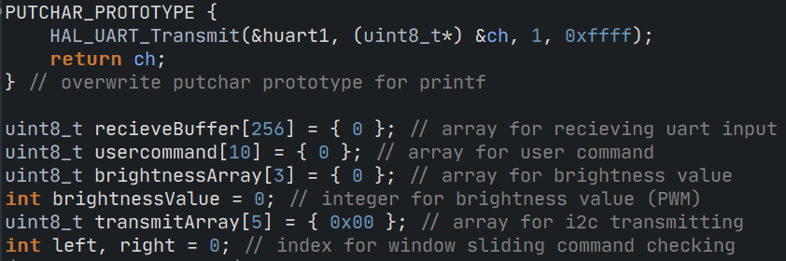
Initialize variables and prototype

Slide 8
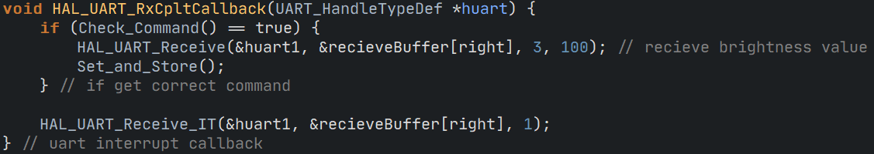
Callback functions for UART

Slide 9
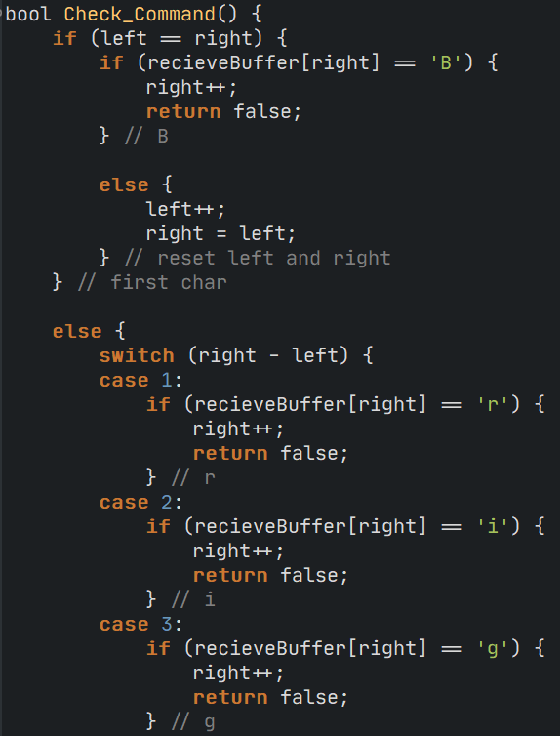
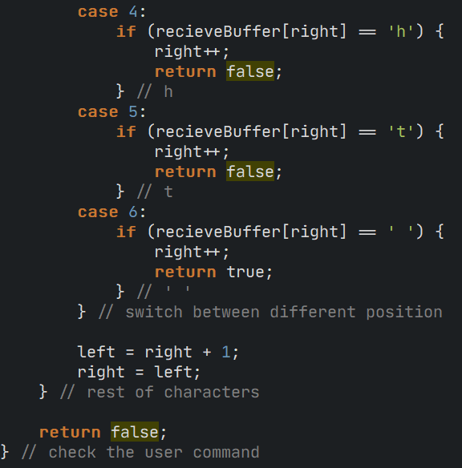
Other custom functions

Slide 10
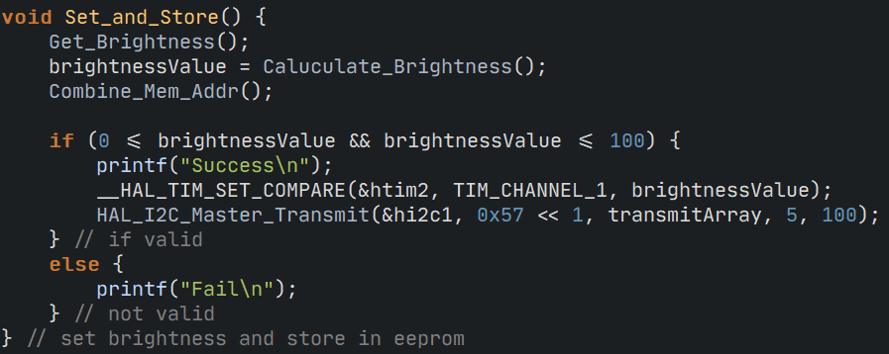
Other custom functions

Slide 11
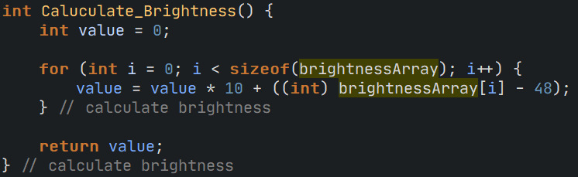
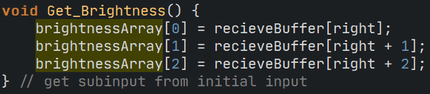
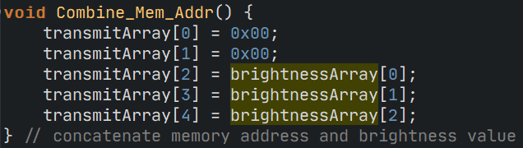
Other custom functions

Slide 12
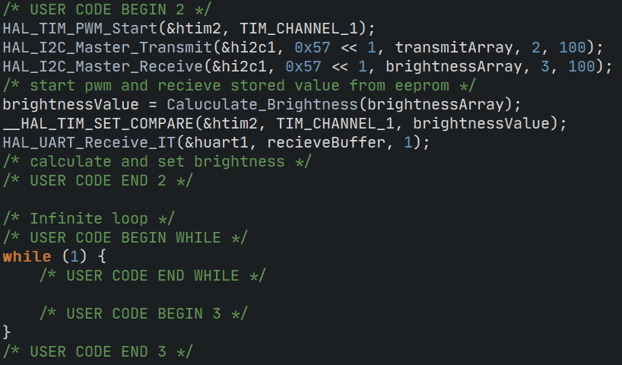
Main

Slide 13
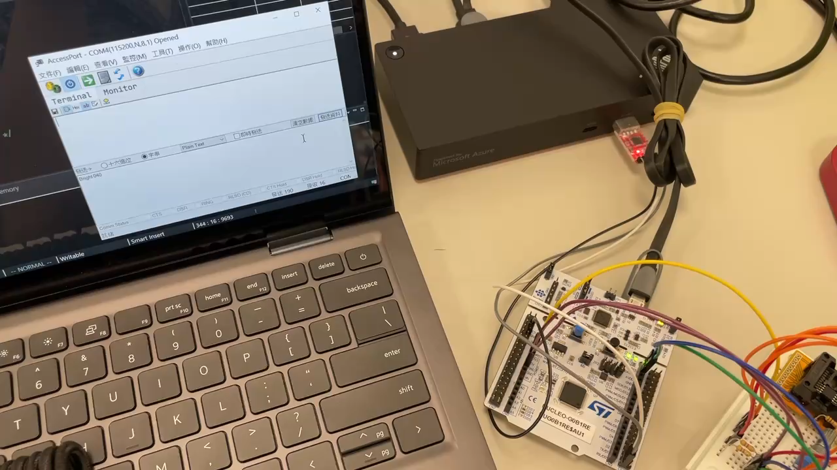
Results

Slide 14

Thank you for your listening
林冠良
Noah_Lin@wistron.com
https://github.com/popshia

Slide 15
Extra
I2C_Simulation

Slide 16
I2C simulation
Simulate I2C signals using GPIO
Write data to EEPROM.
Read data to EEPROM.
Data size should be at least 8 Byte.

Slide 17
Implementation
I2C_Simulation

Slide 18
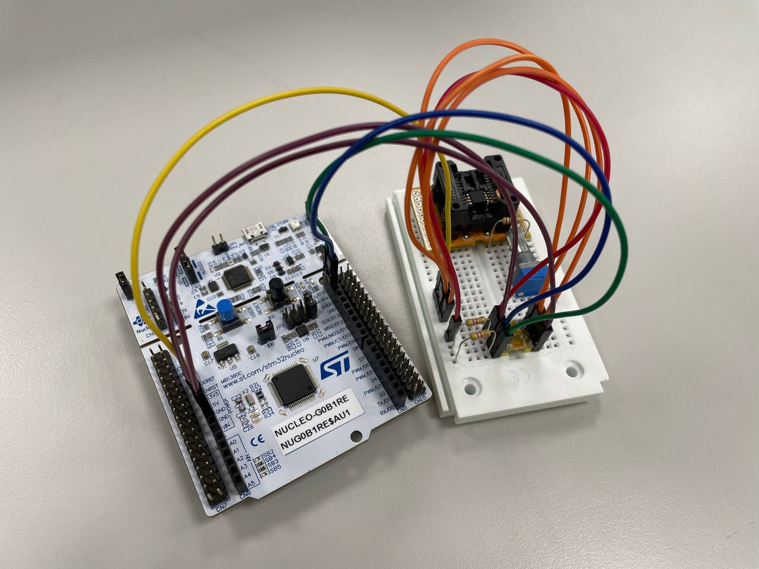
Circuit
E0, E1, E2 and VCC connected to 3V3 in series.
VSS and WC connected to GND.
SCL connected to PB8.
Pull up with 4.7kΩ resistor
SDA connected to PB9.
Pull up with 4.7kΩ resistor

Slide 19
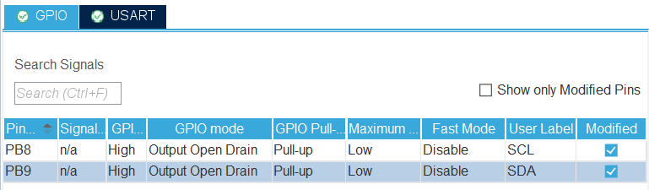
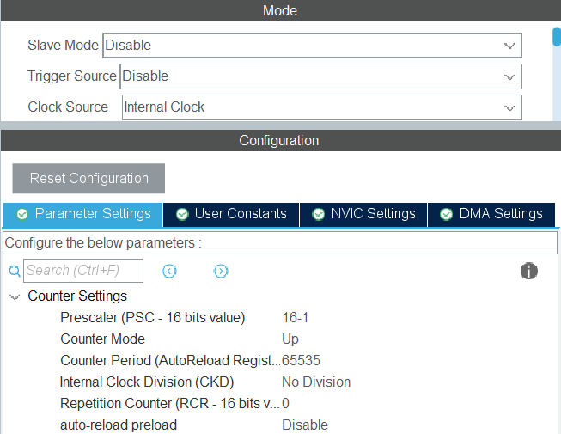
Enable each interface
PB8 (SCL)
GPIO output level: High
GPIO mode: Open Drain
PB9 (SDA)
GPIO output level: High
GPIO mode: Open Drain
TIM1
Prescaler: 16-1 (1 tick per us)

Slide 20
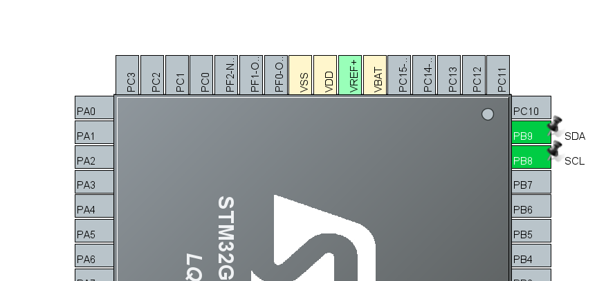
Set the pins
PB9
GPIO_Output
PB8
GPIO_Output

Slide 21
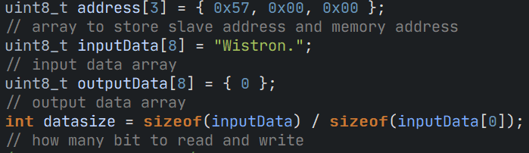
Initialize variables

Slide 22
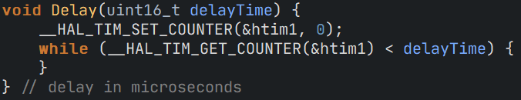
Delay (using Timer)

Slide 23
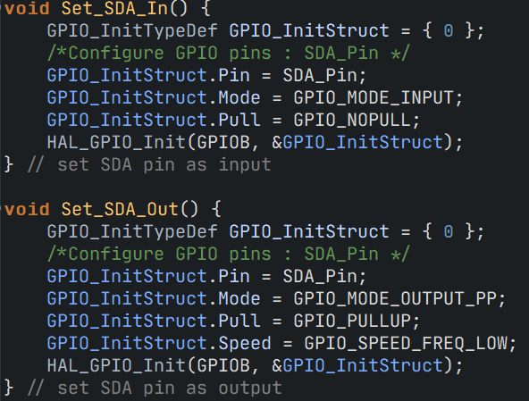
Set SDA Directions

Slide 24
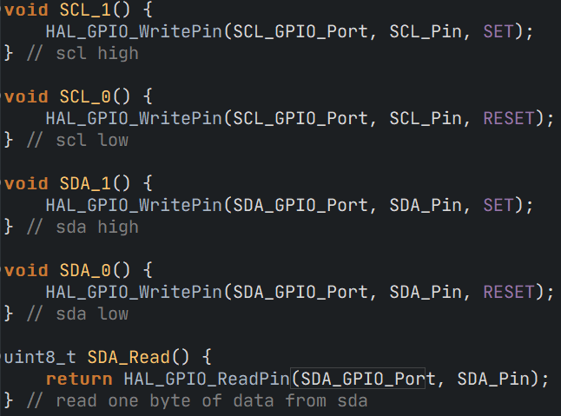
Set SCL/SDA and Read SDA pin

Slide 25
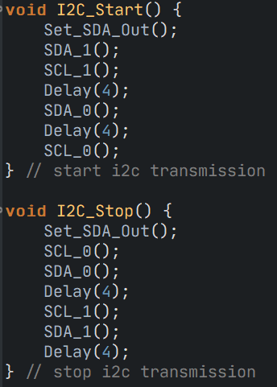
I2C Start/Stop Routine

Slide 26
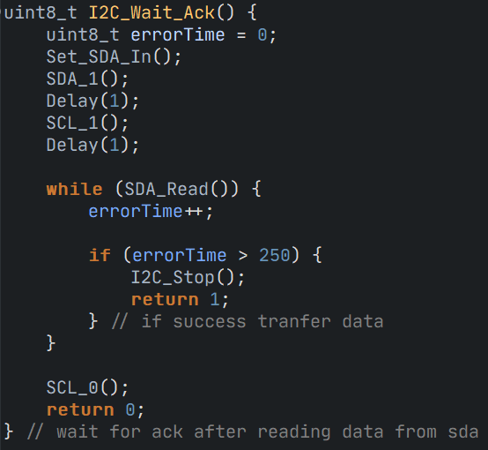
Wait ACK

Slide 27
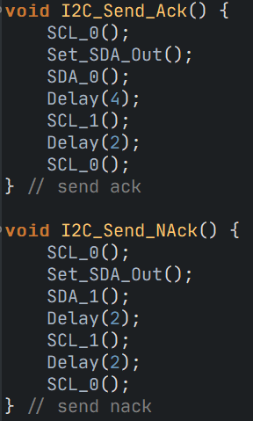
Send ACK/NACK

Slide 28
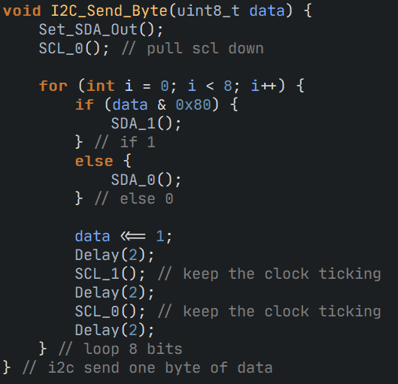
Send a byte of data

Slide 29
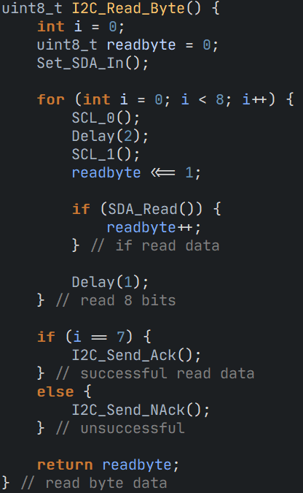
Read a byte of data

Slide 30
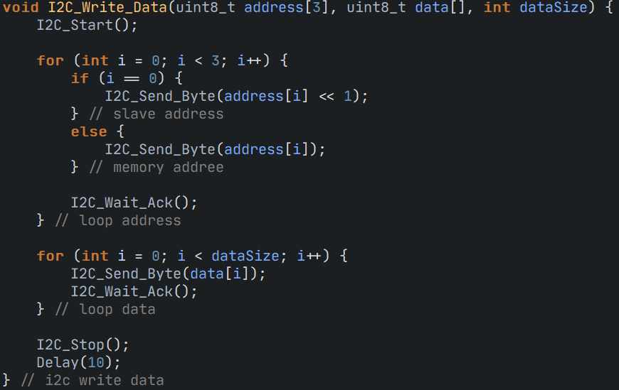
Write an array of data through I2C

Slide 31
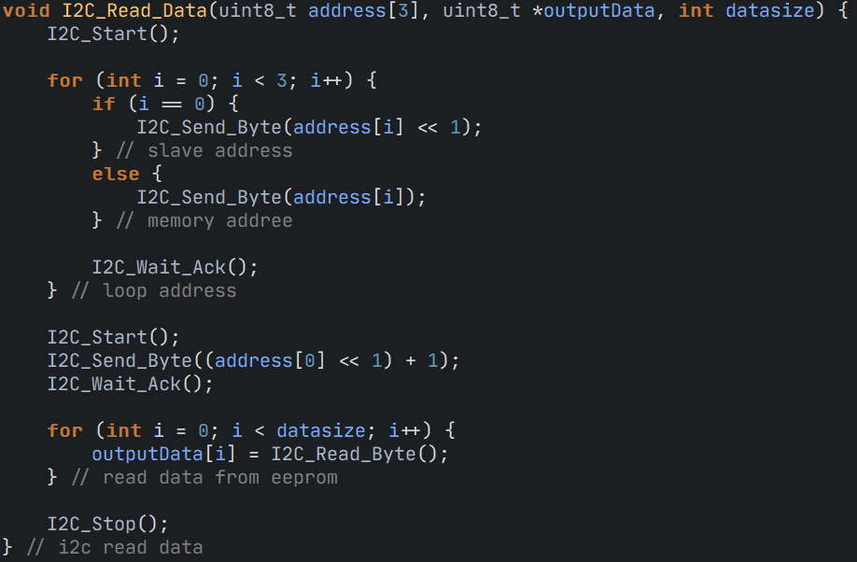
Read an array of data from I2C

Slide 32
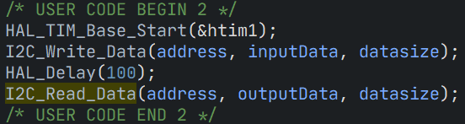
Main

Slide 33
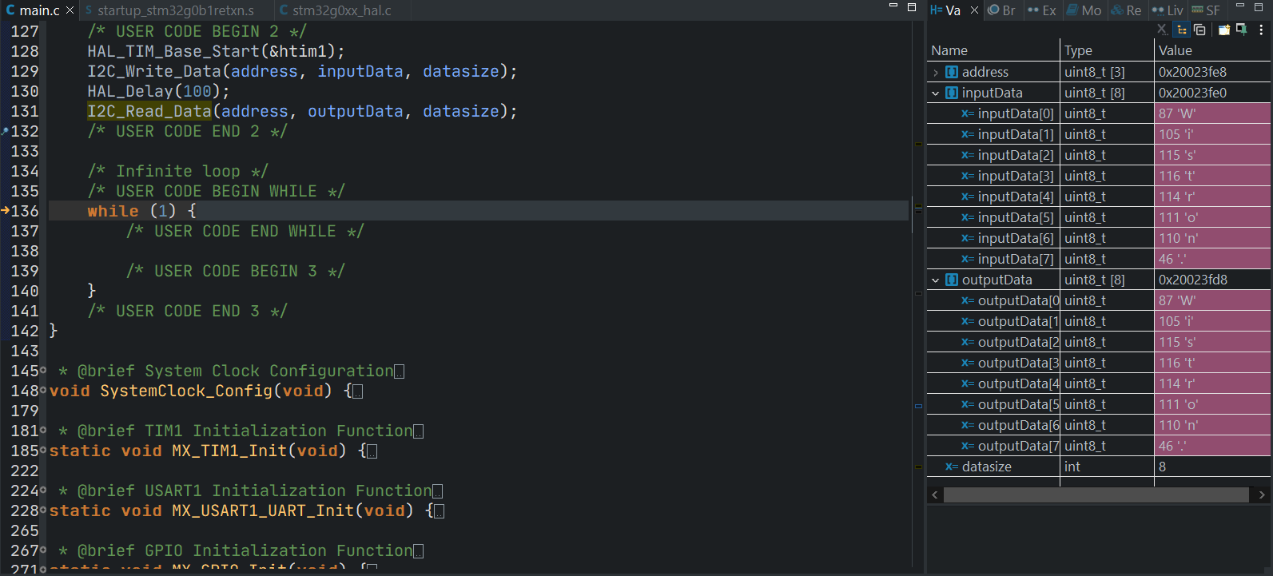
Result

Slide 34
Protocols
What I learned in these two months

Slide 35
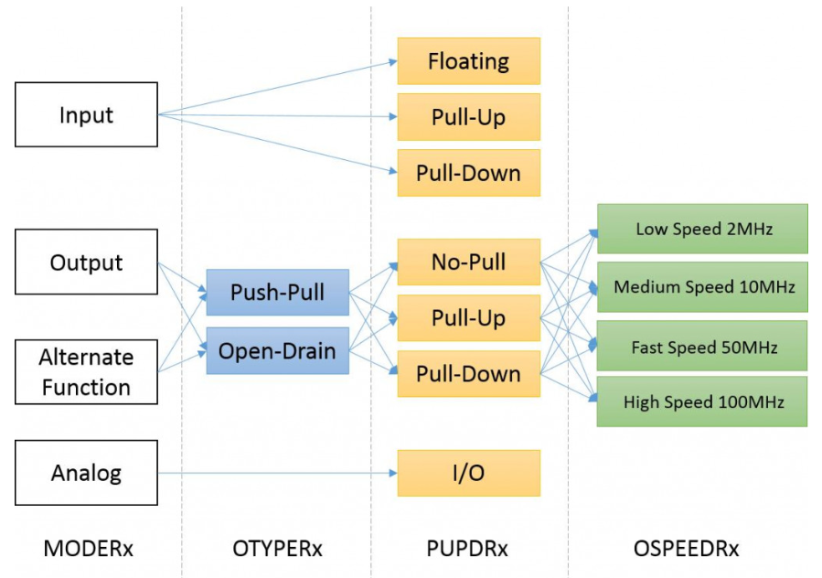
General-purpose input/output (GPIO)
Input
Floating
Pull-up/down
Output
Push-pull
Open drain
Alternative functions(PWM, Timer, UART…etc)
Analog

Slide 36
Timer
Counter max values depends on the bit amount of a timer, if a timer is 8-bit, then it counts from 0-255, then creates an interrupt and resets to 0, over and over.
Prescaler
How fast a timer counts
Counter Period
When does a timer reset
Common hardware functions
Output compare (OC): toggle a pin when a timer reaches a certain value
Input capture (IC): measure the number of counts of a timer between events on a pin
Pulse width modulation (PWM): toggle a pin when a timer reaches a certain value and on rollover. By adjusting the on versus off time (duty cycle), can effectively control the amount of electrical power going to another device.

Slide 37
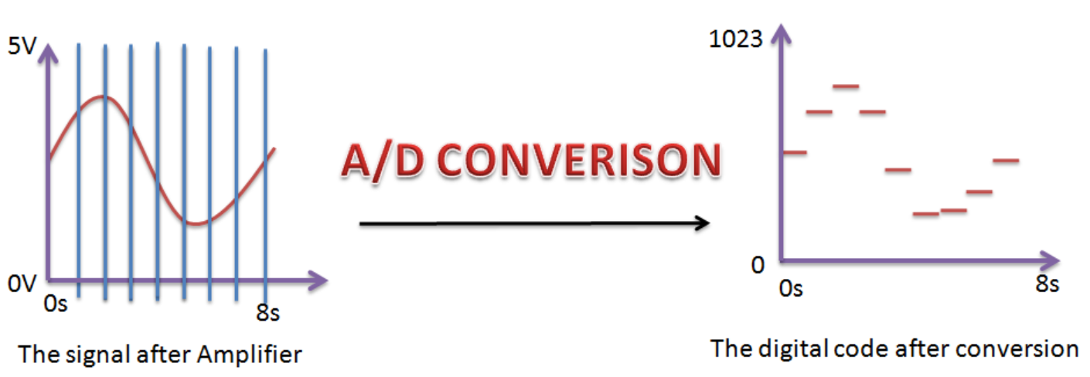
Analog Digital Converter (ADC)
Sampling rate: how long does the signal gets converted
Resolution: how precise does the signal gets converted
Modes:
Single Conversion Mode
Continuous Conversion Mode
Scan Mode
Discontinuous Mode

Slide 38
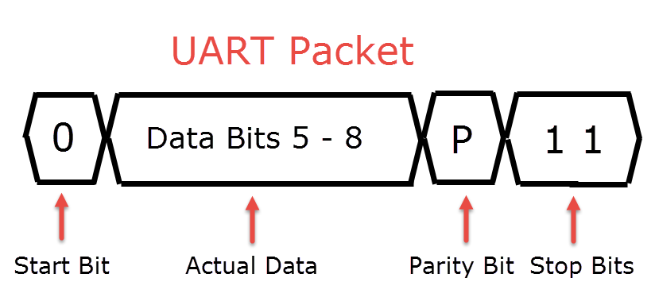
Universal Asynchronous Receiver/Transmitter (UART)
Transmit data asynchronously.
Adds start and stop bits to the data packet being transferred.
Two UARTs communicate directly with each other.
Transmit process
Transmitting UART converts parallel data from a device into serial form.
Transmits it in serial to the receiving UART.
Then converts the serial data back into parallel data for the receiving device.

Slide 39
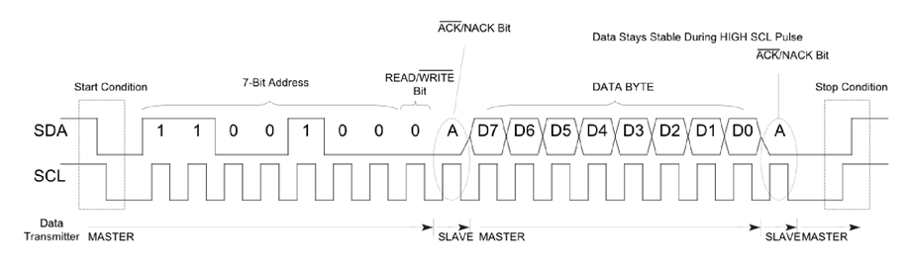
Inter-Integrated Circuit (I2C)
Uses only two bidirectional open-collector or open-drain lines.
Serial data line (SDA) and Serial clock line (SCL)
Pulled up with resistors.
7-bit address space and 1 byte(8-bit) data frame
Speed
Standard mode: 100 kbit/s
Fast mode: 400 kbit/s

